Slide 1

Preparation for Lab 2
Week 4
Semester 1, 2025
Dr. Farshid Keivanian

Slide 2
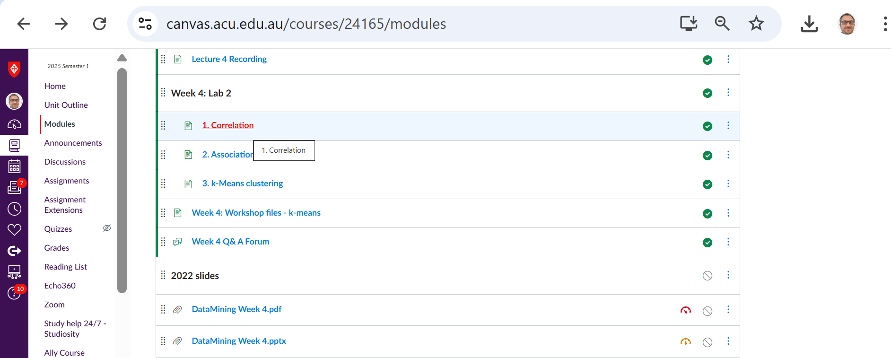
Preparation for Lab 2 (Week 4) – Correlation Analysis
Navigate Canvas >> Week 4: Lab 2 >> Correlation

Slide 3
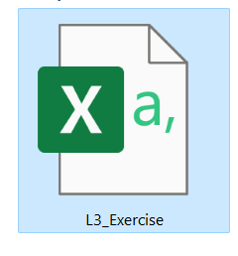
Preparation for Lab 2 (Week 4) – Correlation Analysis
Download Dataset and move it toa path on your machine e.g., D:\ACU\ITEC325
The dataset contains vehicle specifications, including fuel efficiency (MPG), engine attributes, weight, acceleration, and origin, enabling analysis of correlations between these factors.

Slide 4
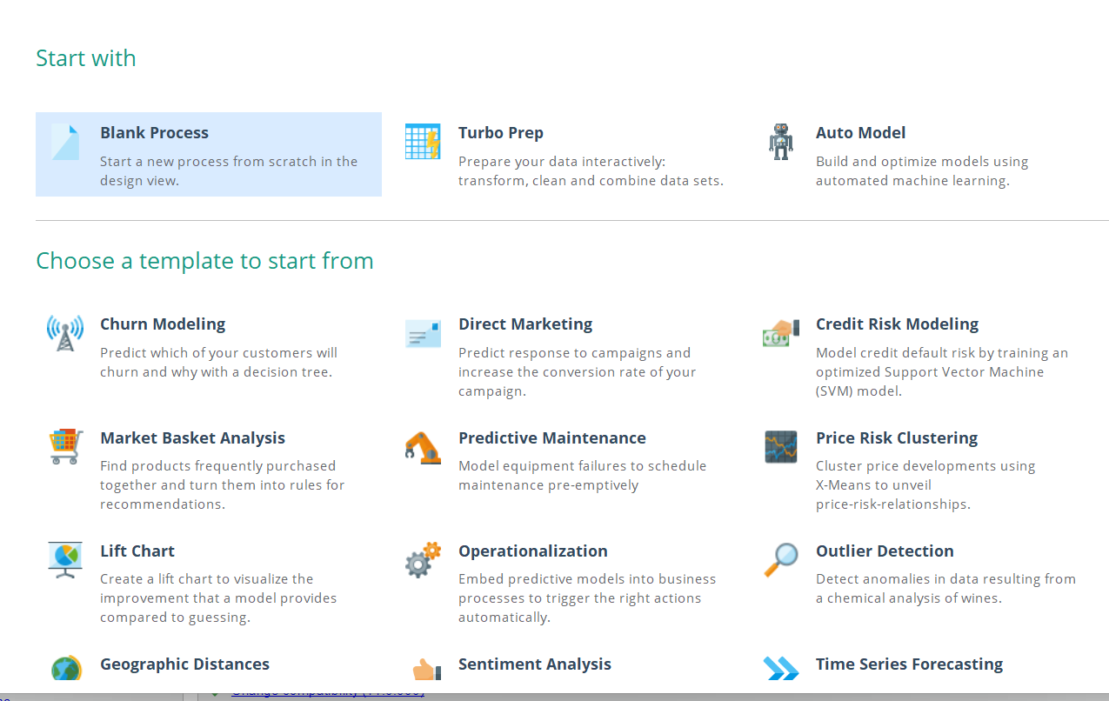
Preparation for Lab 2 (Week 4) – Correlation Analysis
Run Altair AI Studio 2025 >> Blank Process

Slide 5
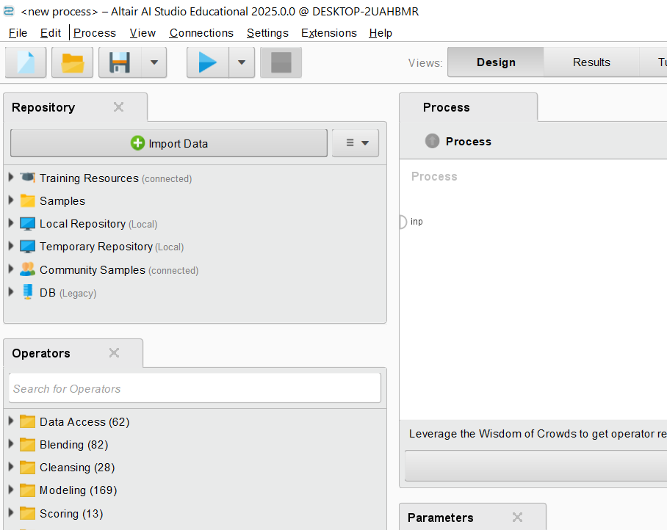
Preparation for Lab 2 (Week 4) – Correlation Analysis
Step 1: Import the Dataset
Open Altair AI Studio.
Go to Repository Panel (on the left).
Click + Import Data → Select L3_Exercise.csv from your files.
Name it Chapter4Exercise or something descriptive.
Click Finish to save it in your repository.

Slide 6
Preparation for Lab 2 (Week 4) – Correlation Analysis
Step 1: Import the Dataset
Open Altair AI Studio.
Go to Repository Panel (on the left).
Click + Import Data → Select L3_Exercise.csv from your files.

Slide 7
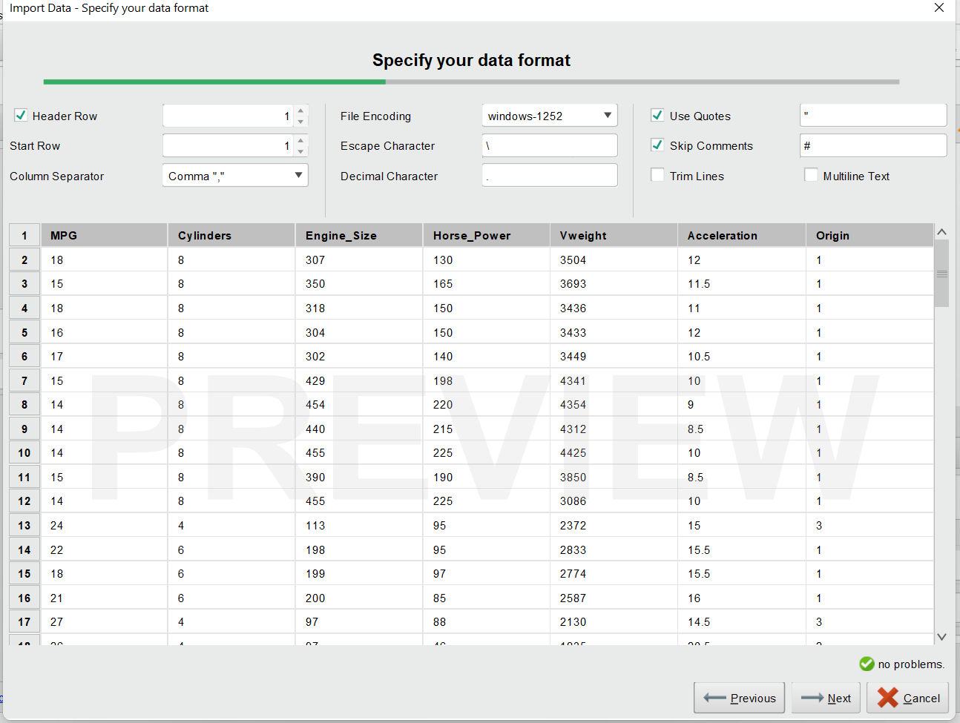
Preparation for Lab 2 (Week 4) – Correlation Analysis
The dataset contains vehicle specifications, including fuel efficiency (MPG), engine attributes, weight, acceleration, and origin, enabling analysis of correlations between these factors.

Slide 8
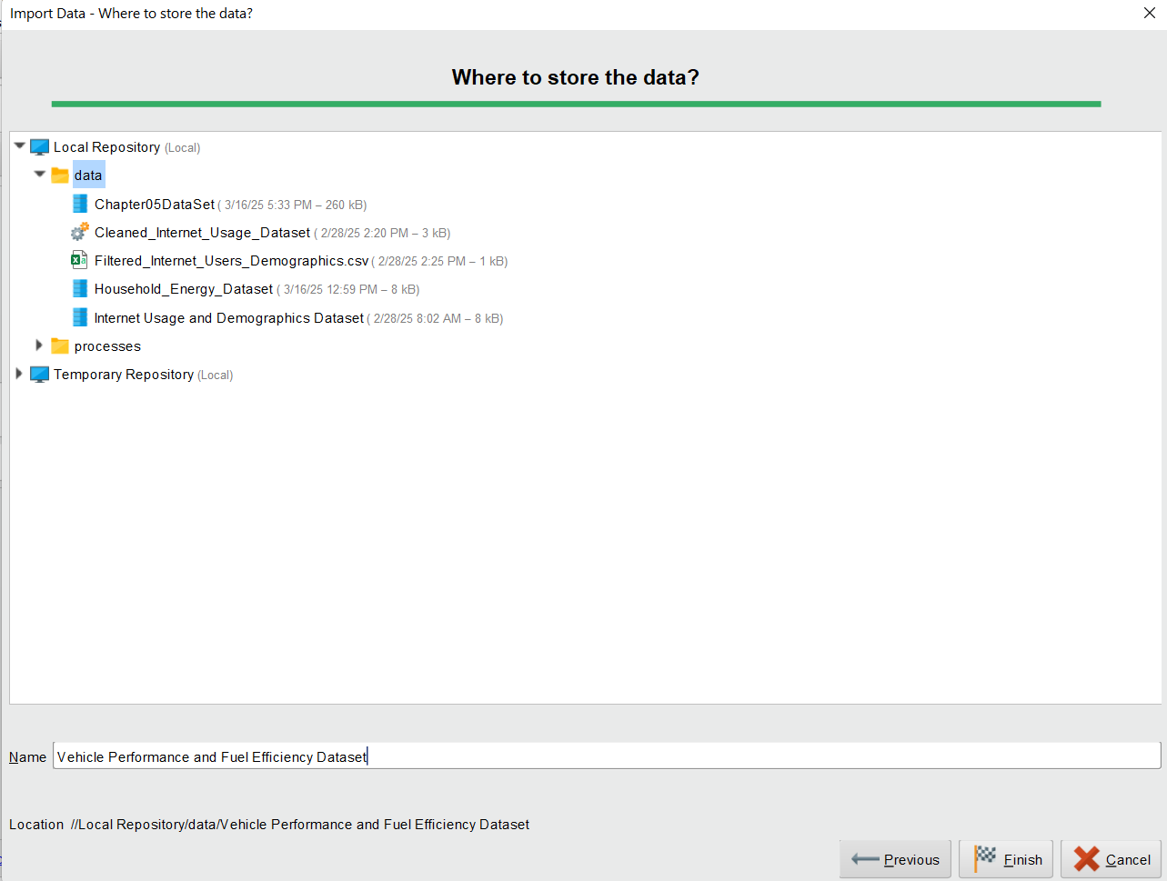
Preparation for Lab 2 (Week 4) – Correlation Analysis
Name it Chapter4Exercise or something descriptive (e.g., Vehicle Performance and Fuel Efficiency Dataset).
Click Finish to save it in your repository.

Slide 9
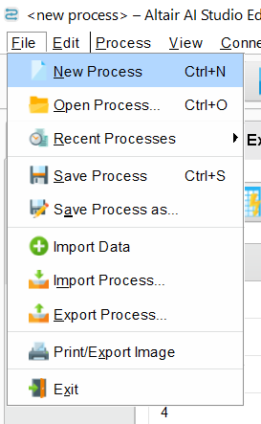
Preparation for Lab 2 (Week 4) – Correlation Analysis
Step 2: Create a New Process
Click File → New Process.
Drag the dataset from the Repository to the Process Window.

Slide 10
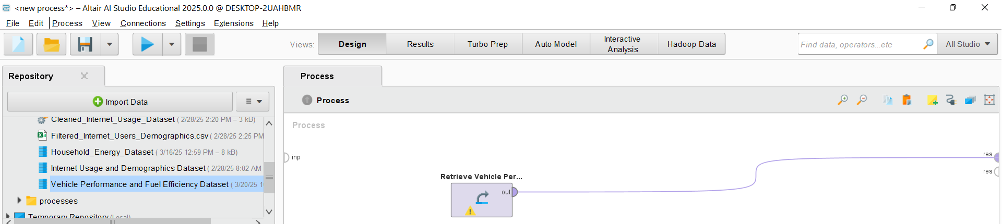
Preparation for Lab 2 (Week 4) – Correlation Analysis
Ensure that the out port of the dataset is connected to the res port.
Click Run to check if the data loads correctly.

Slide 11
Preparation for Lab 2 (Week 4) – Correlation Analysis
Step 3: Check for Missing or Inconsistent Data
Switch to the Results Perspective.
Examine if there are:
Missing values (empty or NaN cells).
Inconsistent values (e.g., negative values where not expected)

Slide 12
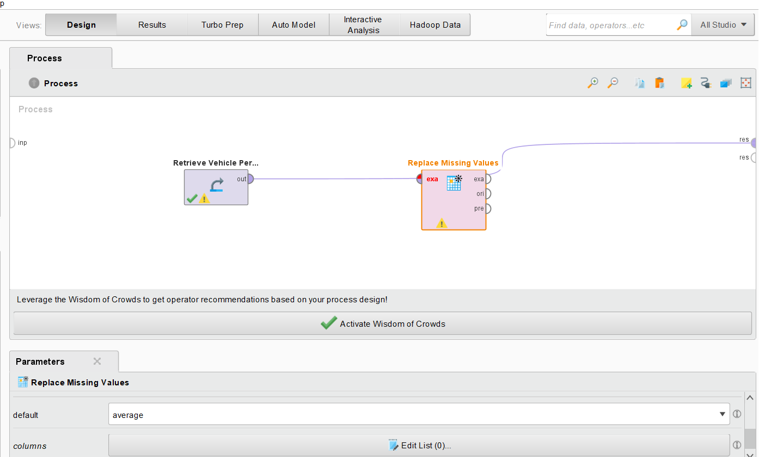
Preparation for Lab 2 (Week 4) – Correlation Analysis
3. If issues exist:
Use the Replace Missing Values operator.
Use the Filter Examples operator to remove incorrect values.

Slide 13
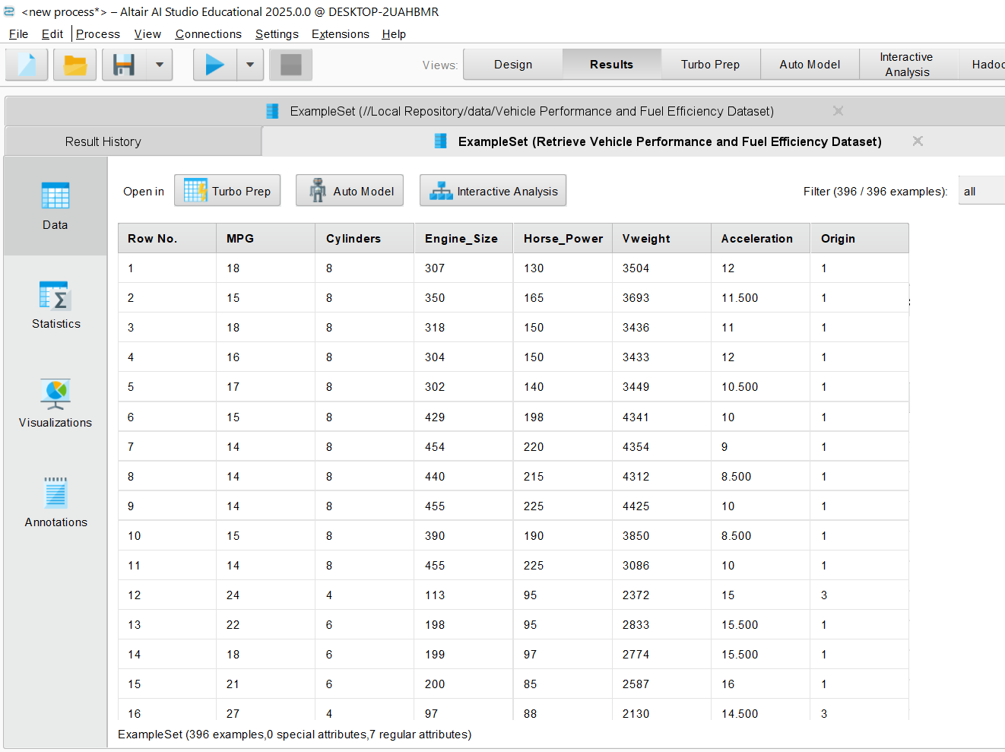
Preparation for Lab 2 (Week 4) – Correlation Analysis
It seems that there is no missing (NaN) value
No negative number found in any numerical column where they are not expected

Slide 14
Preparation for Lab 2 (Week 4) – Correlation Analysis
Step 4) Add the Correlation Matrix Operator
Switch back to the Design Perspective.
Search for Correlation Matrix in the Operators Panel.
Drag it into the Process Window.
Connect:
out of the dataset to the Replace Missing and out of Replace Missing to the correlation matrix operator.
mat (matrix output) of the operator to the res port.
Click Run.

Slide 15
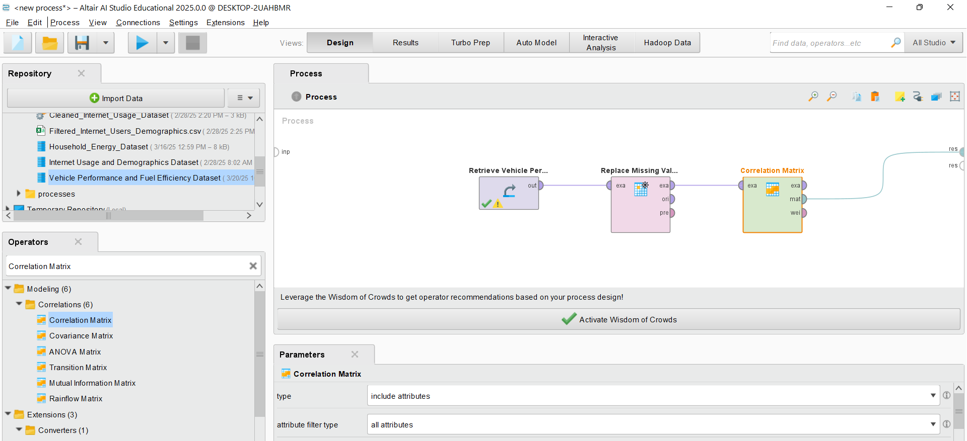
Preparation for Lab 2 (Week 4) – Correlation Analysis

Slide 16
Preparation for Lab 2 (Week 4) – Correlation Analysis
Step 5: Interpret the Results
Go to the Matrix Tab in the Results View.
Look at correlation values (between -1 and 1).
+1 = Perfect positive correlation (both increase together).
-1 = Perfect negative correlation (one increases, the other decreases).
0 = No correlation.

Slide 17
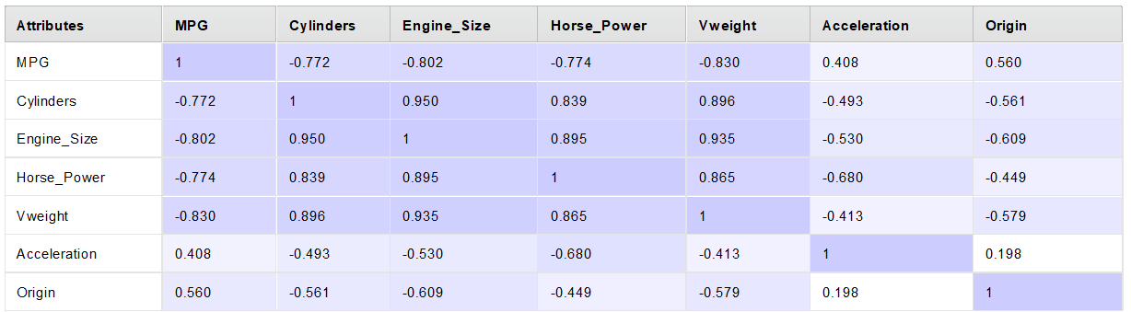
Insights from Correlation Results: MPG (Miles Per Gallon) vs. Other Variables
Strong negative correlation with Engine Size (-0.80), Horse Power (-0.77), and Vehicle Weight (-0.83).
Interpretation: Larger engines, heavier cars, and more powerful engines tend to have lower fuel efficiency.

Slide 18
Cylinders vs. Other Variables
Strong positive correlation with Engine Size (0.95) and Vehicle Weight (0.89).
Interpretation: Cars with more cylinders typically have larger engines and are heavier.

Slide 19
Acceleration vs. Other Variables
Negative correlation with Horse Power (-0.68) and Engine Size (-0.53).
Interpretation: More powerful engines may have lower acceleration values (suggesting higher torque and weight affect acceleration).

Slide 20
Origin vs. Other Variables
Moderate correlation with MPG (0.56).
Interpretation: Cars from different regions may have distinct fuel efficiency trends.

Slide 21
Conclusion and Recommendations
What correlations exist? Strong negative correlation between MPG and engine-related attributes.
How strong are they? Most correlations are above 0.7 or below -0.7, indicating strong relationships.
Are they surprising? Not really—heavier and more powerful cars tend to have worse fuel efficiency.

Slide 22
Would you eliminate any attributes? If the goal is fuel efficiency prediction, Cylinders, Engine Size, and Weight are strongly related and might be redundant.
What additional attributes could help? Aerodynamics, transmission type, and fuel type could provide better insights.

Slide 23
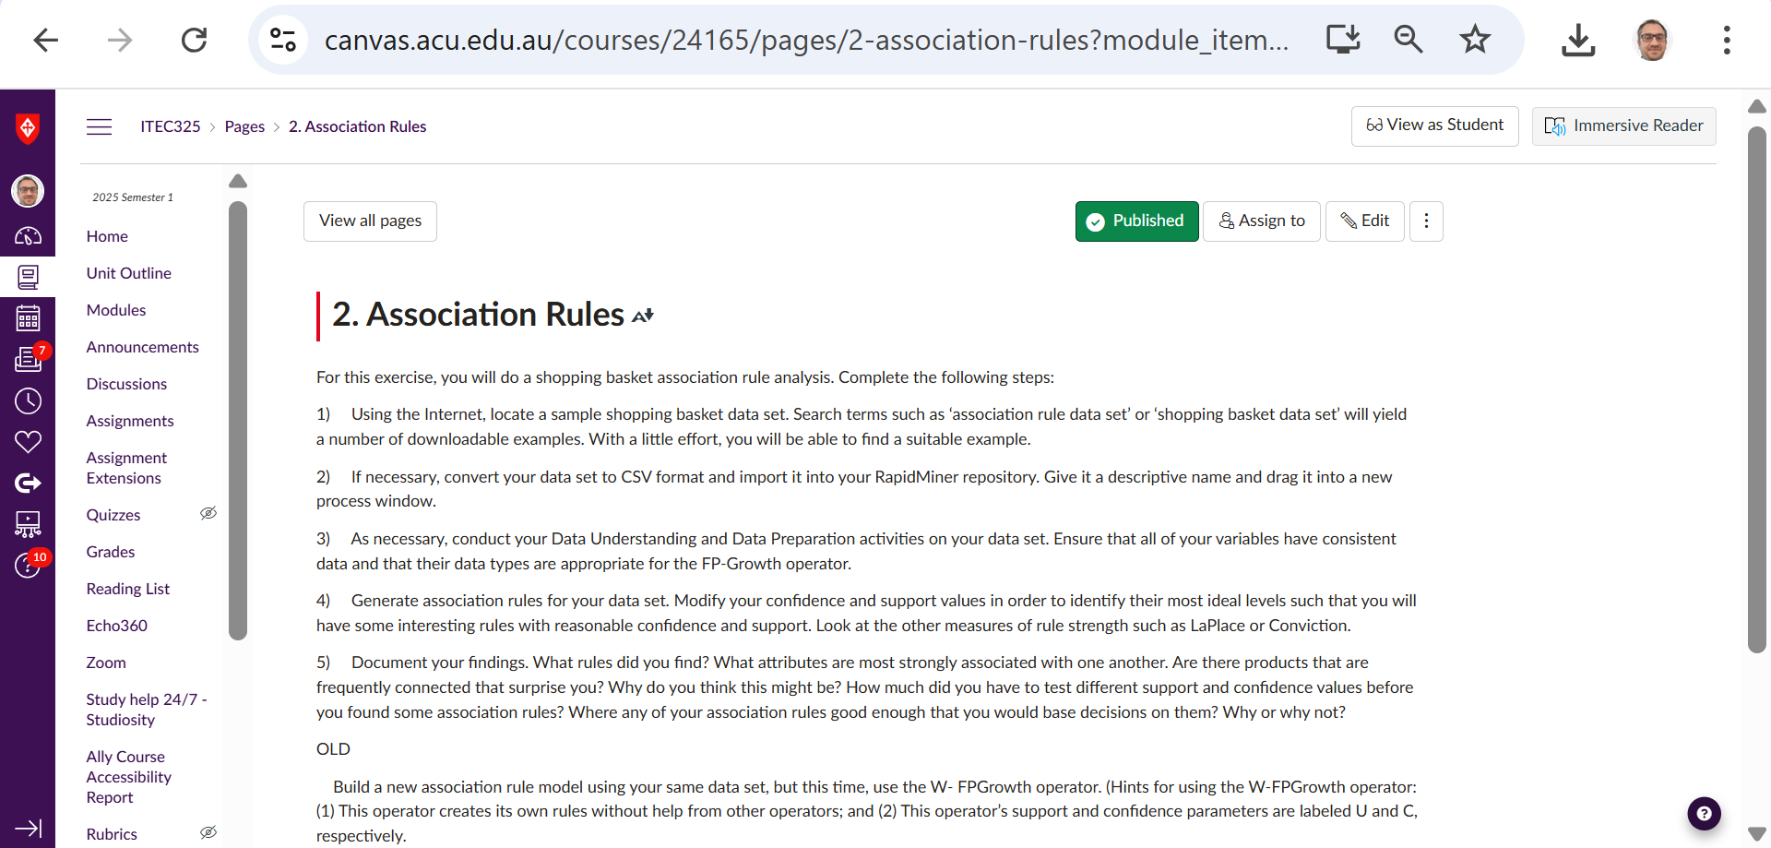
Preparation for Lab 2 (Week 4) – Association Rules

Slide 24
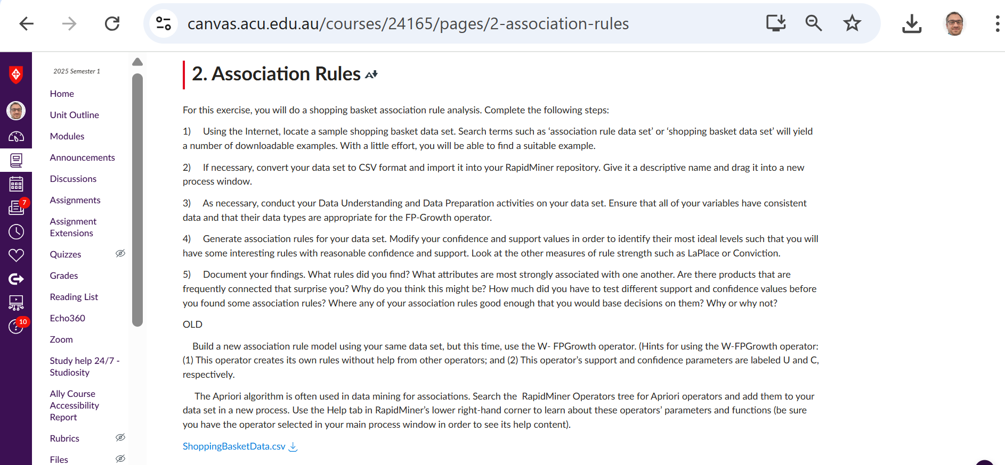
Preparation for Lab 2 (Week 4) – Association Rules
This dataset is an extension of Chapter05DataSet.csv: A new Shopping Basket Dataset with 100 transactions and typical grocery items (Milk, Bread, Eggs, Cheese, Butter, Soda, Chips, Coffee, Tea, Cereal).

Slide 25
Recap: Association Rules
What are Association Rules?
Association rules are a data mining technique used to find relationships between different items in a dataset.
The goal is to discover frequent patterns that help understand which items often appear together.

Slide 26
Recap: Key Measures in Association Rules
Measure | Definition | Example
Support | How often a set of items appears in the dataset. | 20% of customers buy milk and bread together.
Confidence | Given that one item is bought, how often the second item is bought. | 70% of customers who buy a smartphone also buy a case.
Lift | How much more likely two items are bought together compared to chance. | Lift = 2 means customers are twice as likely to buy both items together than randomly.

Slide 27
Recap: Why Does it Matter?
Helps businesses increase sales by understanding customer behavior.
Improves product recommendations (Amazon, Netflix, Spotify).
Supports marketing strategies (e.g., bundle deals, personalized offers).

Slide 28
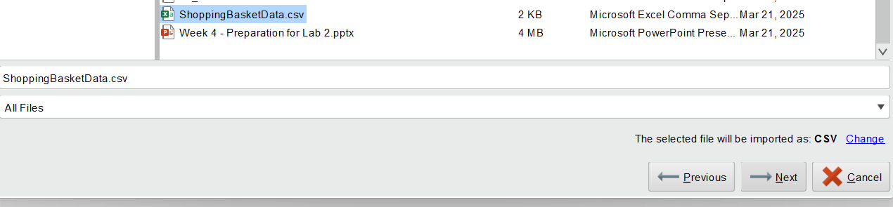
Shopping Basket Association Rule Analysis
Step 1: Import the Shopping Basket Dataset
Open Altair AI Studio (RapidMiner).
Click File → New Process to start a new project.
Import the dataset:
Click on Import Data in the Repository Panel.
Select ShoppingBasketData.csv
Click Next, name it Shopping Basket Transactions, and save it in your repository.
Drag the dataset into the Process Window.

Slide 29
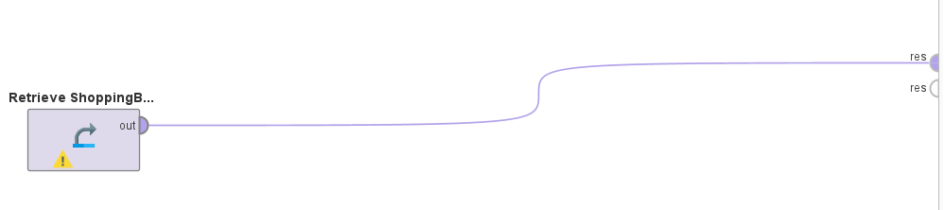
Shopping Basket Association Rule Analysis
Step 2: Data Understanding and Preparation
Connect and Run the process (Click Run).
Check the Results Tab:
Look for missing values.
Ensure all item columns are in binary format (0 = Not Purchased, 1 = Purchased).
If issues exist, use:
Replace Missing Values operator (set to mode/0).
Numerical to Binominal operator (if any non-binary data exists).

Slide 30
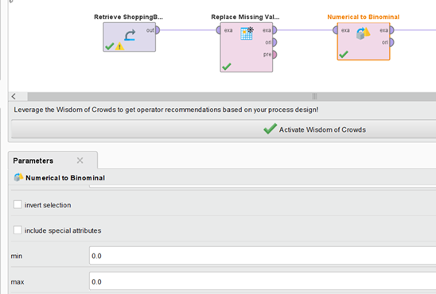
Shopping Basket Association Rule Analysis
For the next Step, Applying FP-Growth in Altair AI Studio (RapidMiner), the values should be in True/False format instead of 0/1.
Why Convert 0/1 to True/False?

Slide 31
Shopping Basket Association Rule Analysis
The FP-Growth operator in RapidMiner expects binomial (Boolean) data.
Some association rule mining operators might interpret 0 as a numerical value, which is incorrect for categorical analysis.
Converting 0 → False and 1 → True ensures that each item is treated as a category presence (True) or absence (False) rather than a numerical value.

Slide 32
Shopping Basket Association Rule Analysis
To ensure there are no missing value or non-binary data, we apply both Replace Missing Value and Numerical to Binominal Operators

Slide 33
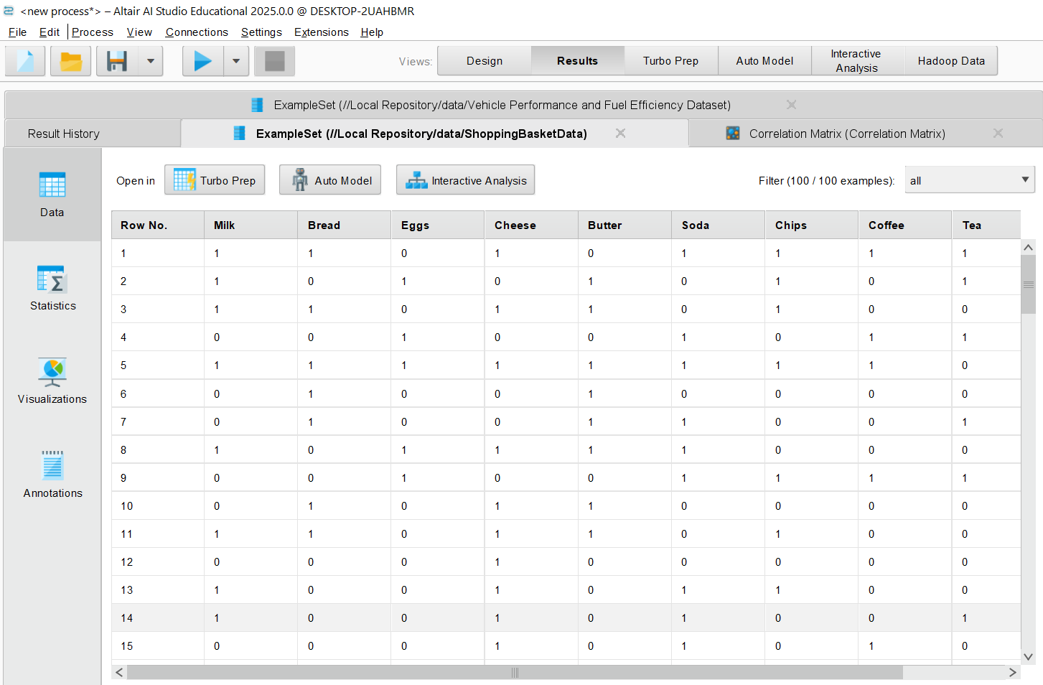
Shopping Basket Association Rule Analysis
Results

Slide 34
Shopping Basket Association Rule Analysis
Step 3: Applying FP-Growth (Frequent Pattern Mining)
Switch to Design Perspective.
Search for “FP-Growth” in the Operators Panel.
Drag FP-Growth into the process.
Parameter settings: min requirement: support min support: 0.2 min items per itemset: 1 max items per itemset: 5 max number of itemset: 1000000

Slide 35
Shopping Basket Association Rule Analysis
min number of itemsets: 100 max number of retries: 15 requirement decrease factor: 0.9

Slide 36
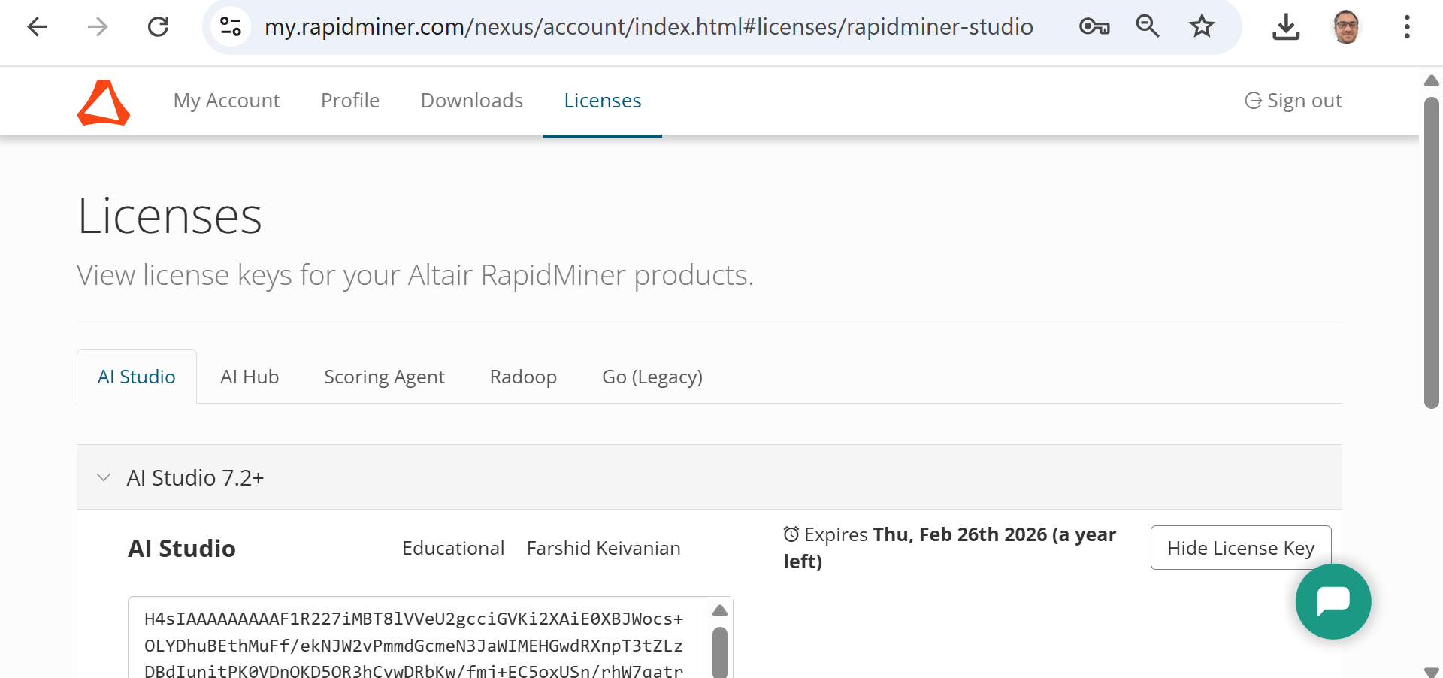
Shopping Basket Association Rule Analysis
To ensure license is working or activated for you:
Go to your Account to Sign - Use your ACU email you used for installation: https://my.rapidminer.com/nexus/account/index.html#login?returnUrl=https%3A%2F%2Fmy.rapidminer.com%2Fnexus%2Faccount%2Findex.html%23home

Slide 37
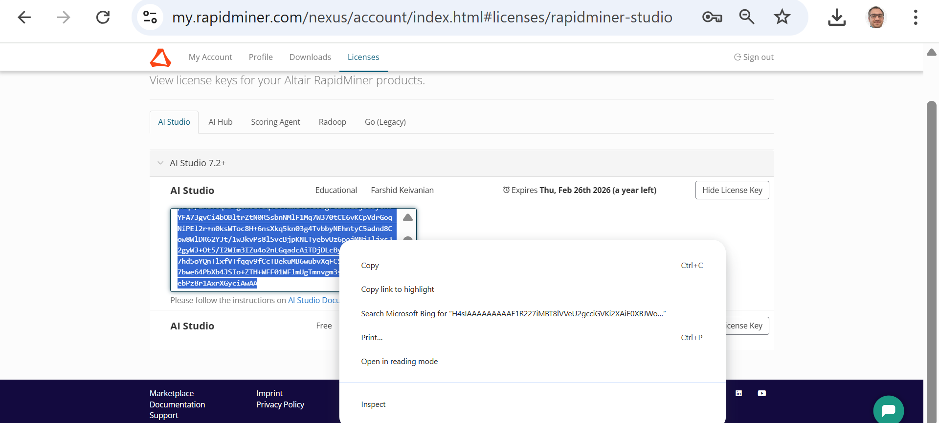
Shopping Basket Association Rule Analysis
Right Click and Copy the License

Slide 38
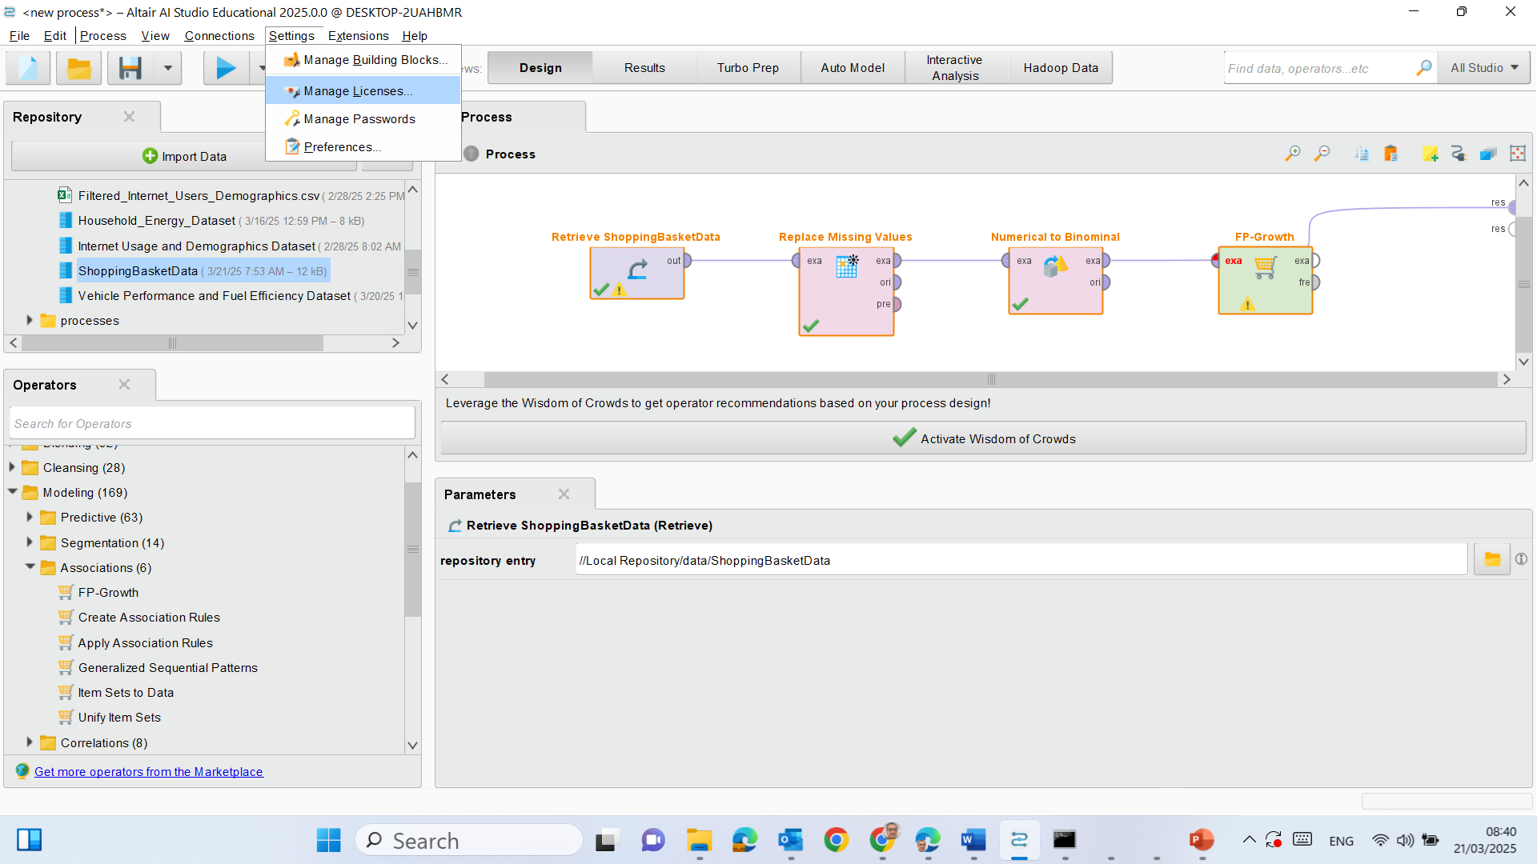
Shopping Basket Association Rule Analysis
Go to Settings >> Manage Licenses

Slide 39
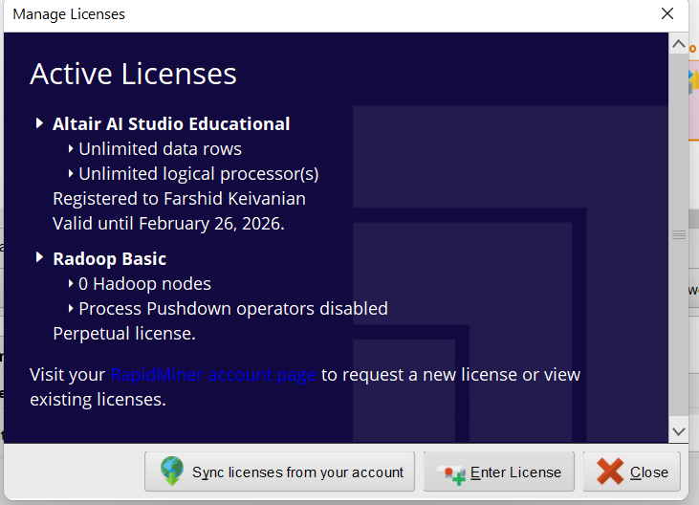
Shopping Basket Association Rule Analysis
Enter License

Slide 40
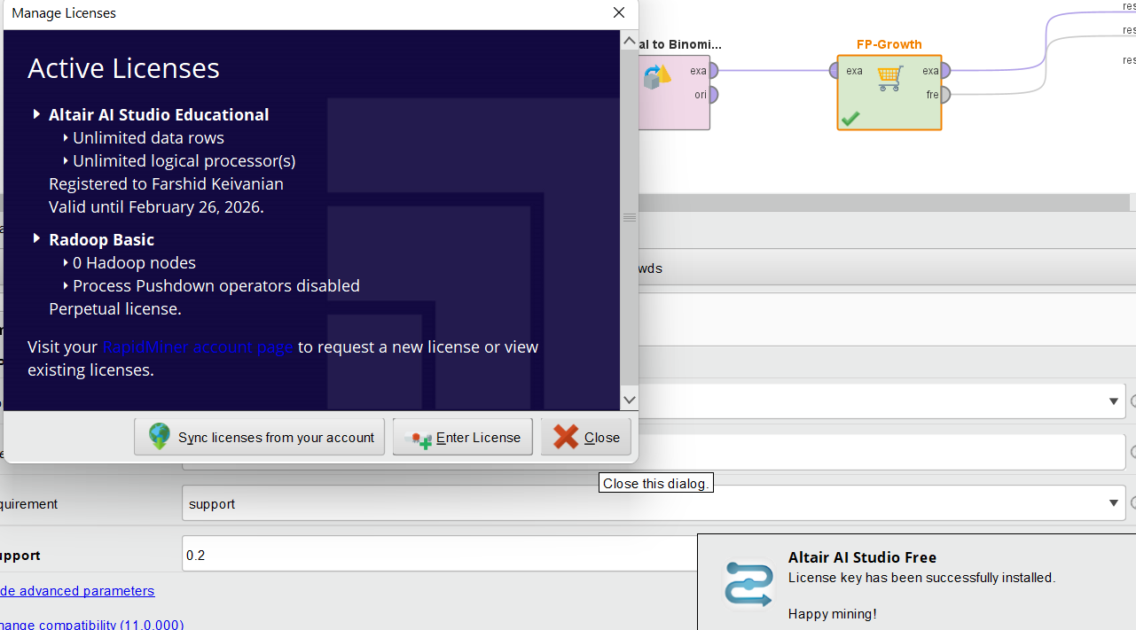
Shopping Basket Association Rule Analysis
License Key has been successful installed.
Happy mining!

Slide 41
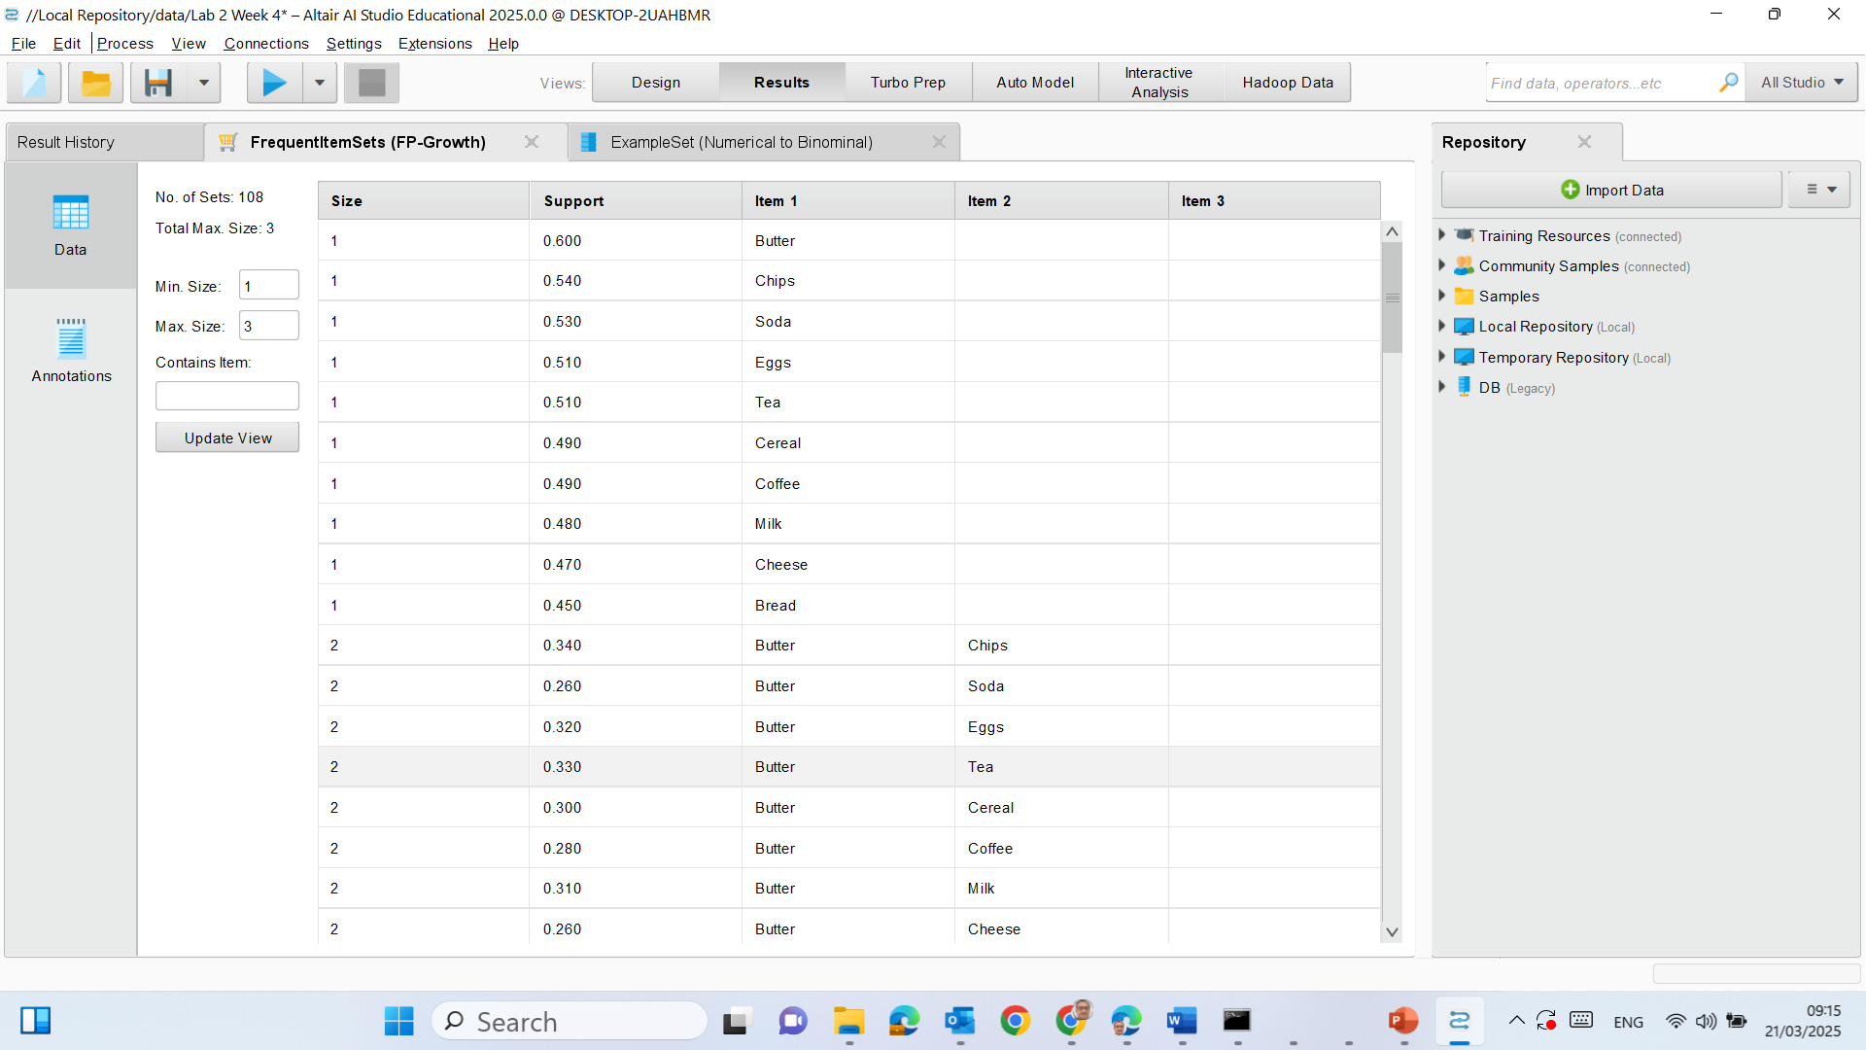
Shopping Basket Association Rule Analysis
Size → The number of items in the itemset (1 = single item, 2 = pairs of items, etc.).
Support → The proportion of transactions that contain the itemset.
Item 1, Item 2, Item 3 → The actual products frequently appearing together.

Slide 42
Shopping Basket Association Rule Analysis
Most Frequent Items (Support ≥ 50%) Butter (60%) → This means Butter appears in 60% of all transactions.
Chips (54%)
Soda (51%)
Eggs (51%)
Tea (49%)
Cereal (48%)
Coffee (49%)
Milk (48%)
Cheese (47%)
Bread (45%)

Slide 43
Shopping Basket Association Rule Analysis
These items are very commonly purchased.
If we were in a retail environment, these products might be good candidates for promotions or discounts.

Slide 44

Shopping Basket Association Rule Analysis
Frequently Bought Together (Size = 2)
Butter & Chips (Support: 34%) → Butter and Chips appear in 34% of transactions.
Butter & Soda (26%)
Butter & Eggs (32%)
Butter & Tea (33%)
Butter & Cereal (30%)
Butter & Coffee (28%)
Butter & Milk (31%)
Butter & Cheese (26%)

Slide 45
Shopping Basket Association Rule Analysis
Butter is the most commonly paired item (it appears in multiple frequent itemsets).
Customers who buy Butter tend to buy Eggs, Tea, and Chips frequently.
If we were in a supermarket setting, placing Butter near Eggs or Chips could increase sales.

Slide 46
Shopping Basket Association Rule Analysis
Next Step: Generating Association Rules
Now that we know which items frequently appear together, we should generate association rules (Step 4).
Association rules will tell us the probability that buying one item will lead to buying another.
For example, a rule might say:
If a customer buys Butter, there is a 70% chance they will also buy Chips.

Slide 47
Shopping Basket Association Rule Analysis
Step 4: Generate Association Rules
Search for “Create Association Rules” in the Operators Panel.
Drag it into the Process Window.
Connect it:
Link FP-Growth’s output port (frequent itemsets) to Create Association Rules’ input port.

Slide 48
Shopping Basket Association Rule Analysis
Set Parameters:
Criterion: Confidence
Min Confidence: 0.7 (adjust to find meaningful rules).
Gain theta: 1.0
Laplace k: 1.
Max Consequent Length: 1.
Run the Process and examine the rules.

Slide 49
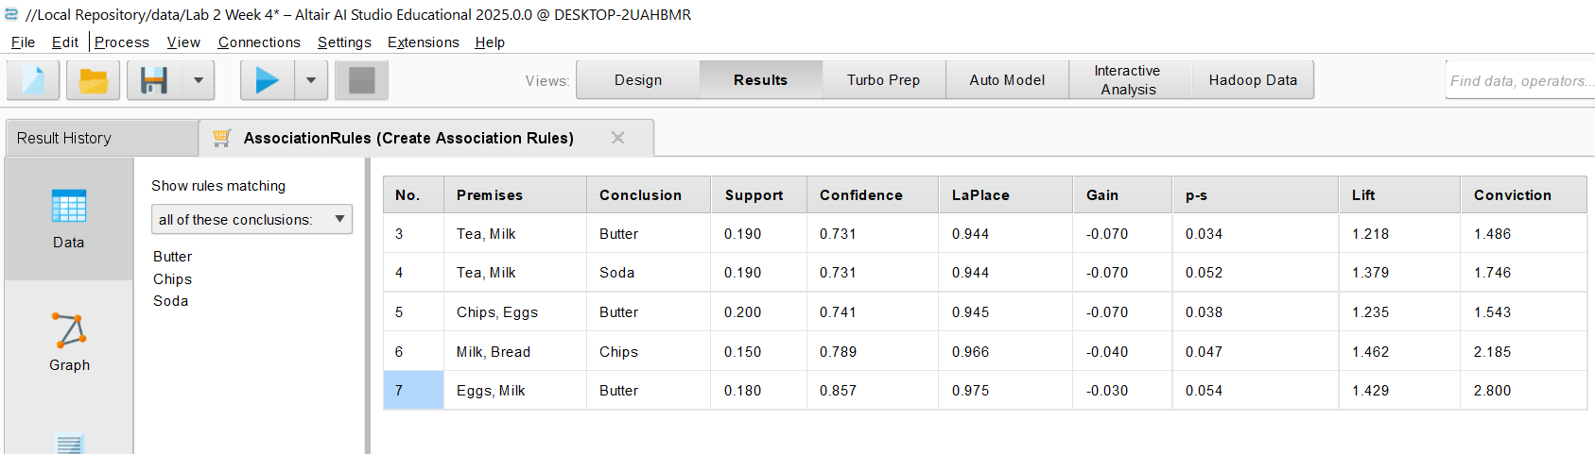
Shopping Basket Association Rule Analysis
Provide your key findings, business insights, and recommendations in your report

Slide 50
Shopping Basket Association Rule Analysis
In your report, provide your key findings, business insights, and recommendations in your report

Slide 51
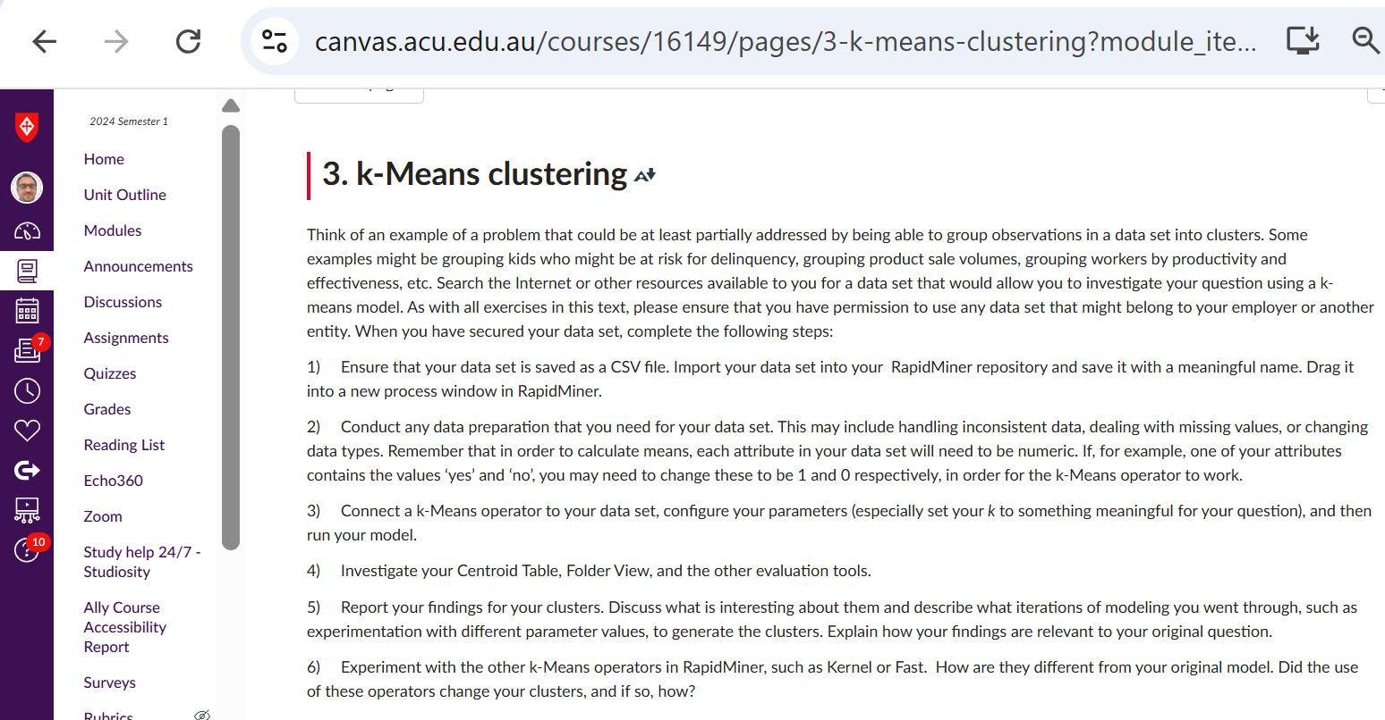
K-Means Clustering

Slide 52
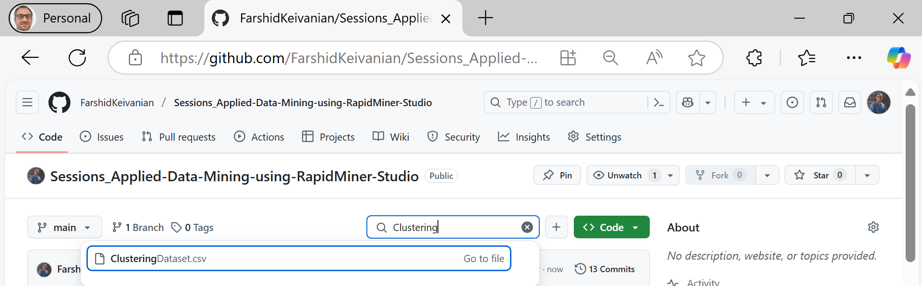
K-Means Clustering
One Example Dataset

Slide 53
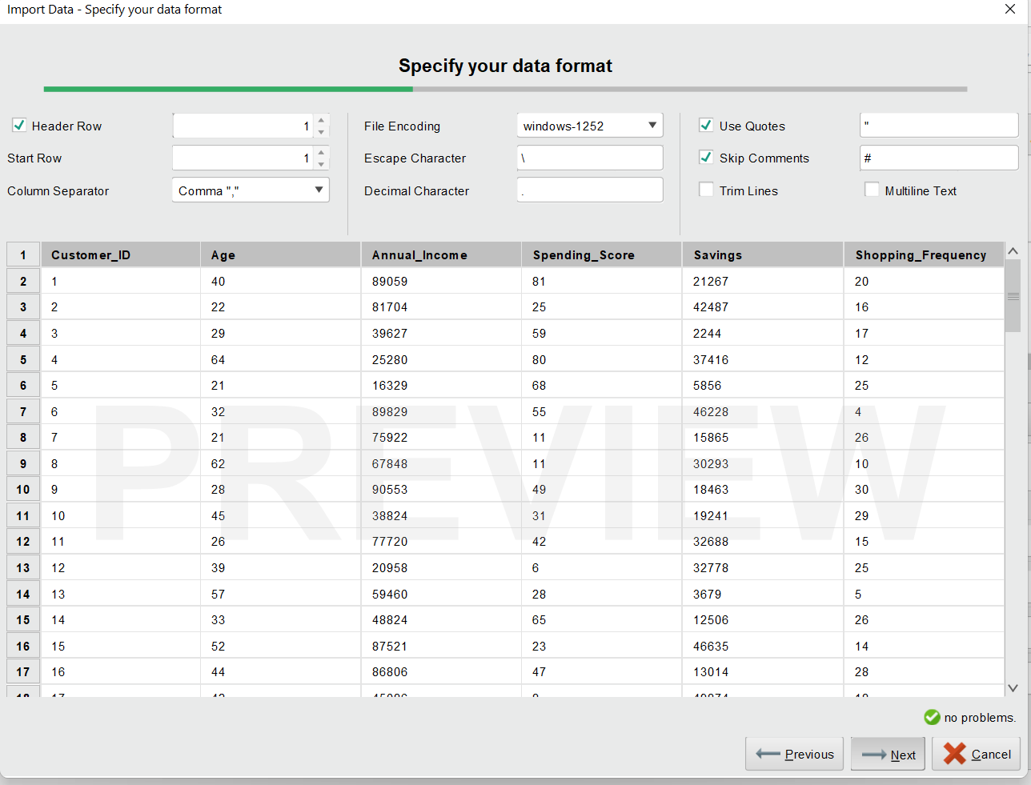
K-Means Clustering
This dataset is suitable for k-Means clustering and can be used to identify customer groups based on shopping behavior.
Load >> Drag & Drop into the Process Window

Slide 54
K-Means Clustering
Check for missing values & inconsistencies:
Run the process once and inspect the data in the Results tab.

Slide 55
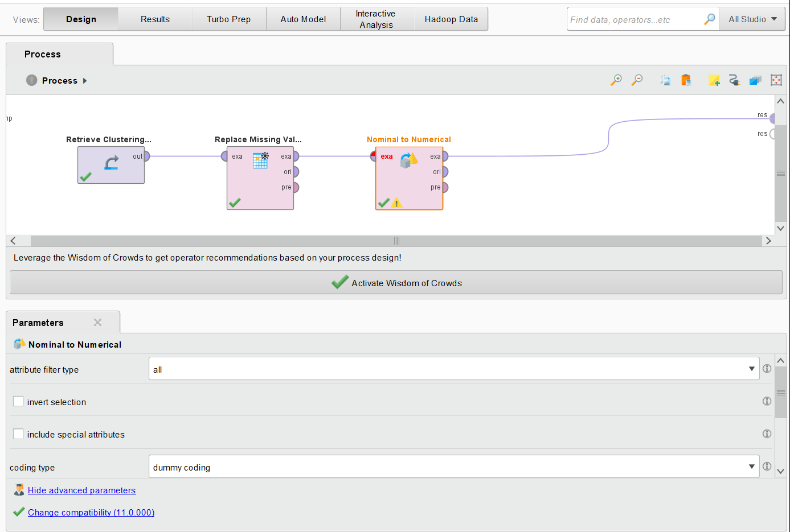
K-Means Clustering
If any column has missing values:
Use Replace Missing Values operator.
If categorical values exist (e.g., "Yes/No"), convert them to 0/1 using Nominal to Numerical.

Slide 56
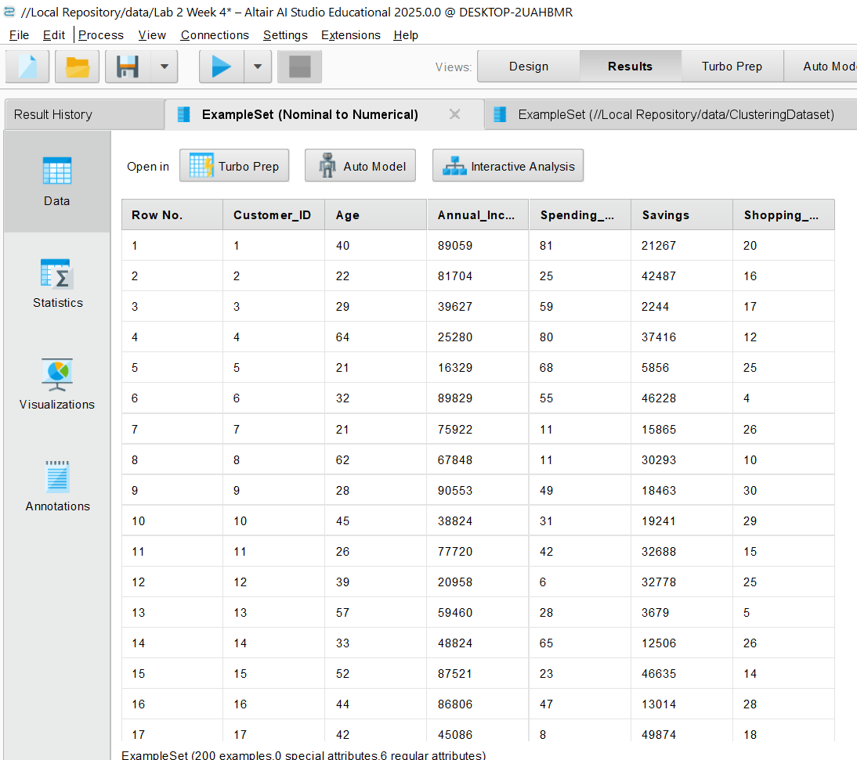
K-Means Clustering
Run to See the Results
The dataset contains 200 customers with the following attributes:
Age (18-65 years)
Annual Income ($16,170 - $119,714)
Spending Score (0-100)
Savings ($1,044 - $49,874)
Shopping Frequency (1-30 visits per month)

Slide 57
K-Means Clustering
Apply k-Means Clustering
Search for "k-Means" in the Operators Panel.
Drag "k-Means" into the process window.
Connect it:
Link the dataset’s output port (out) to k-Means' input port (exa).
Recommended value for K (number of clusters) is 3-5, Try K = 4 first

Slide 58
max runs
Definition: The number of times the k-Means algorithm will re-run with different initial centroids.
Purpose: k-Means starts with random centroids, so running it multiple times helps find a better clustering result.
Impact:
A higher number of runs (e.g., 10) increases the chance of better cluster stability.
If too low (e.g., 1-3), the model might get stuck in a bad local optimum.
Default = 10 (recommended for most cases).
Best Practice: Keep max runs around 10-20 to ensure better centroids.

Slide 59
max optimization steps
Definition: The maximum number of iterations per run before stopping.
Purpose: Controls how long k-Means keeps refining cluster assignments.
Impact:
If too low (e.g., 10-50), the model might not fully converge.
If too high (e.g., 500+), unnecessary iterations may increase computation time.
Default = 100 (recommended for most cases).
Best Practice: Keep max optimization steps between 100-300 unless clusters are not converging.

Slide 60
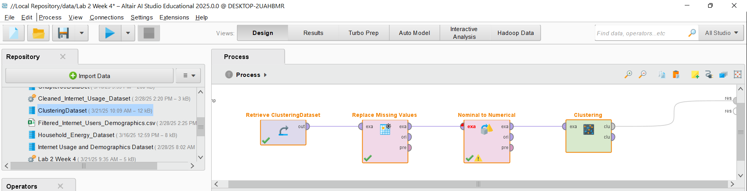
Run and Analyse the Results

Slide 61
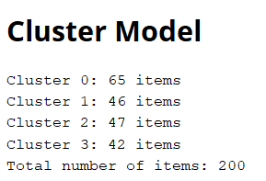
Run and Analyse the Results
Cluster Distribution: The dataset of 200 customers has been grouped into 4 clusters with sizes:
Cluster 0 → 65 customers (largest group)
Cluster 1 → 46 customers
Cluster 2 → 47 customers
Cluster 3 → 42 customers (smallest group)

Slide 62
Run and Analyse the Results
Interpretation:
The clusters appear reasonably balanced, indicating that k=4 was a good choice.
To understand the differences between clusters, check the Centroid Table (age, income, spending score, etc.).

Slide 63
Submission of Labs & Assessments
These guidelines are designed to support your learning and help you apply necessary techniques effectively. For lab or assessment submissions, please follow instructions and complete tasks based on Canvas. If you have any questions, feel free to ask—I’m happy to help!

Slide 64
Thank You
Have a Great Learning Day!
Feel free to reach out with any questions!
Dr. Farshid Keivanian

